Slide 1

An Online Marketplace Site Migrates from Universal Analytics to GA4 & Fixes Faulty Web Analytics Reports
A GOOGLE ANALYTICS CASE STUDY
CLIENT: Gear Supply www.gearsupply.com

Slide 2

An Online Marketplace Site Migrates from Universal Analytics to GA4 & Fixes Faulty Web Analytics Reports
A GOOGLE ANALYTICS CASE STUDY
About The Client
www.gearsupply.com is a niche online marketplace for used Audio Video equipment in the US. The site allows suppliers to list their less-used AV equipment. The site also prides itself on providing a great buying experience to the buyers.
One of the main facilities provided by Gear Supply to their suppliers is cross-platform marketing exposure through advertisements. While on the consumer side, their quality guarantee scheme stands out.
Clearly, web analytics is crucial for Matt, the founder of the site, to measure many aspects of his growing e-commerce business.

Slide 3

An Online Marketplace Site Migrates from Universal Analytics to GA4 & Fixes Faulty Web Analytics Reports
A GOOGLE ANALYTICS CASE STUDY
The Requirement
When Matt approached us, he had listed 13 issues from Google Analytics reports that he was pulling his hair around.
Not only did he want these issues to be resolved, but he also wanted a root cause analysis to be done so that the reporting would improve in general and the issues he had not discovered yet would also be resolved.
He was aware that some shortcut approaches he had taken were back firing.

Slide 4

An Online Marketplace Site Migrates from Universal Analytics to GA4 & Fixes Faulty Web Analytics Reports
A GOOGLE ANALYTICS CASE STUDY
The Complexity
When we examined the list of 13 issues, 2 issues stood out,
For purchases done through ads, Matt was using the traffic report. He wanted the advertisement 1st Page visited by the user to be shown against the dollar value. Instead, the way the report was configured, it showed the landing page of the session visited to which it happened to /account or /cart page for most of the transactions.
user_id was misconfigured. Google Analytics was capturing different user_ids for the same user. This indirectly had an impact on the traffic report, as we found later.

Slide 5
An Online Marketplace Site Migrates from Universal Analytics to GA4 & Fixes Faulty Web Analytics Reports
A GOOGLE ANALYTICS CASE STUDY
Migration from Universal Analytics to GA4
A Test Based Approach
As we looked at the list of issues, it was clear that many GearSupply would be better off migrating from Universal Google Analytics to GA4.
Our approach to developing solutions was to discover the root causes.
For this, we tested intermediate configurations. If a configuration did not solve an issue, we moved one layer deeper to address the problem more holistically.
This made sure the final implemented solutions were fool-proof.
Root Cause Analysis - Development of Test Configurations
Fool-proof solution development
User testing and Rollout

Slide 6


An Online Marketplace Site Migrates from Universal Analytics to GA4 & Fixes Faulty Web Analytics Reports
A GOOGLE ANALYTICS CASE STUDY
The Solution
Our first step was to migrate from Universal Analytics to GA4. This was not only necessary from Google’s support perspective, but also from a solution implementation perspective.
For example, creating custom dimensions would have been complex and time taking in Universal Analytics but it was a cakewalk in GA4. Moving to GA4 reduced the testing time also, with the debug view showed us the necessary parameters in order understand if the implementation is correct or requires modifications against configuration changes took effect in real-time.
In the process of migration, we made configuration improvements that solved most of the direct configuration & reporting issues.

Slide 7
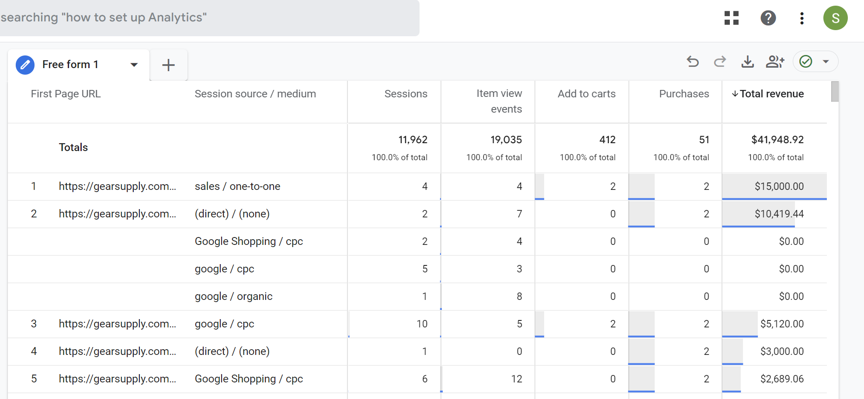
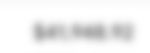
A D2C Company Measures Direct Revenue Impact of Product Advertisements Embedded in their Blog Articles
A GOOGLE ANALYTICS CASE STUDY
The Solution
To show the “1st page visited URL” by each user in the traffic report, we first tested the impact of increasing session time to 8hrs. If it worked, it would save changes in the report. Though the landing page showed up in the report in 80% of cases, it wasn’t a fool-proof solution.
So, next, we built a custom dimension for “1st page visited URL” in GA4. We built a JavaScript variable in Google Tag Manager which recorded the landing page URL. The URL was passed to GA4 as a dimension.
The final piece was to resolve the issue of user_id capture. The site was using a Google Analytics plugin which was misconfigured and giving faulty data.
We uninstalled the plugin and instead used a GTM variable to assign a unique user_id. This resolved the issue for good.

Slide 8

An Online Marketplace Site Migrates from Universal Analytics to GA4 & Fixes Faulty Web Analytics Reports
A GOOGLE ANALYTICS CASE STUDY
The Outcome
All 13 issues were resolved.
www.gearsupply.com was successfully migrated to GA4 thereby simplifying many reporting aspects. It also helped us reduce the time to deliver the solutions.
The traffic report showed the advertisement “1st page visited URL” against each purchase as a separate dimension. This is a far better reporting structure than what Mendel had expected.
User_id is getting captured and showing up accurately in all the reports.

