Slide 1

A D2C Company Measures Direct Revenue Contribution of the Product Advertisements Embedded in their Blog Articles
A GOOGLE ANALYTICS CASE STUDY
CLIENT: Nectar Medical Vapes www.nectarmedicalvapes.com

Slide 2

A D2C Company Measures Direct Revenue Contribution of the Product Advertisements Embedded in their Blog Articles
A GOOGLE ANALYTICS CASE STUDY
About The Client
www.nectarmedicalvapes.com is a D2C e-commerce site that supplies dry herb vaporizers.
Providing a wide range of products, they have a mature e-commerce setup.
Catering to a niche audience, for Nectar Medical Vapes building trust with their audience is key to the success of their business model. For this, they publish many information blog articles educating their audiences on various aspects of medical vaporizers.

Slide 3
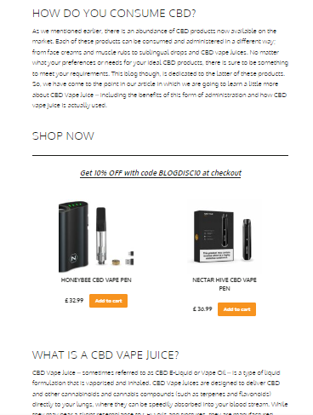
A D2C Company Measures Direct Revenue Impact of Product Advertisements Embedded in their Blog Articles
A GOOGLE ANALYTICS CASE STUDY
The Requirement
The e-commerce site www.nectarmedicalvapes.com
is built using WordPress and woo-commerce, and has a mature GTM and GA setup for measuring the traffic, business, and revenue analytics.
While blog articles on their site are a crucial part of their community-building efforts, the articles are embedded with product displays.
The founders wanted to understand how much of the revenue was directly coming from clicks on these embedded product displays.

Slide 4

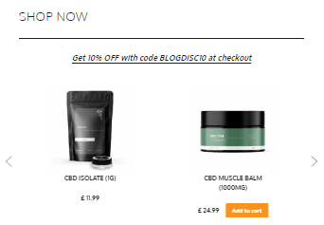
A D2C Company Measures Direct Revenue Impact of Product Advertisements Embedded in their Blog Articles
A GOOGLE ANALYTICS CASE STUDY
The Complexity
The main complexity was the persistence of GTM data across multiple pages i.e., from blog articles to the checkout page across multiple sessions. The solution was the creation of 1st Party Cookie.
But the challenge was there were two different formats of displays inside the blog articles – two product grids & four product slider grids.
The founders wanted a listing of direct revenue from each blog article for both display formats. This meant the blog URL and advertisement format both were to be captured and persisted.

Slide 5
A D2C Company Measures Direct Revenue Impact of Product Advertisements Embedded in their Blog Articles
A GOOGLE ANALYTICS CASE STUDY
Solution Selection
Our Approach
We did quick tests to see if a programmatic or a template-based solution will work best in this case. Both were viable options.
In the end, we decided to tackle it programmatically using GTM JavaScript Variable because the passing of the URL information was clean and simple this way.
Once our solution was finalized, we audited the GA4 and GTM setups. We pointed out two gaps in GA4 setup and plugged them.
We developed the solution directly on the production instances with remote admin access to GA4 and GTM.
After the solution was implemented, and the persistence and correct population of GTM variables was tested, we asked the client to carry out dummy purchases. The revenue was correctly captured in the GA4 property.
GA4 & GTM Audit & Corrections
Remote Solution Development
Client Testing

Slide 6
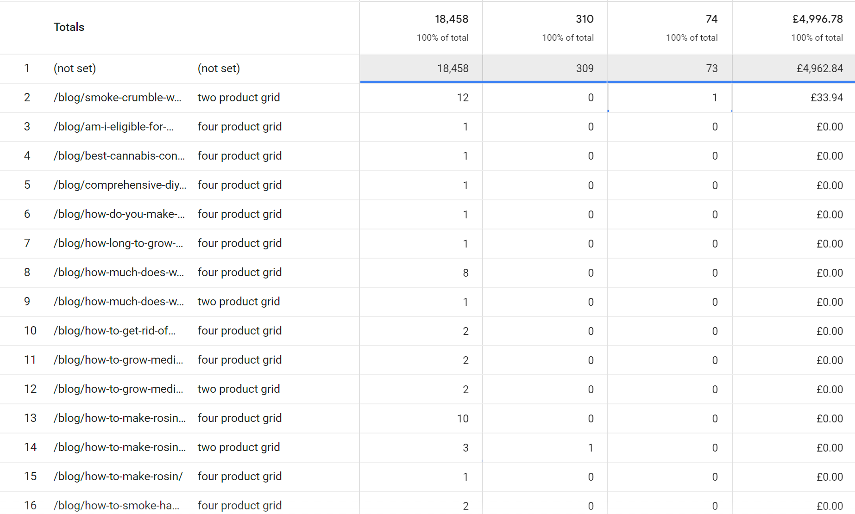
A D2C Company Measures Direct Revenue Impact of Product Advertisements Embedded in their Blog Articles
A GOOGLE ANALYTICS CASE STUDY
The Solution
We developed Javascript code for the creation of a GTM cookie that captured both the blog URL and the advertisement format.
During the GA4 audit, we fixed two setup gaps
Google signals were turned on to capture demographic data
Data retention was changed from 2 months default to 14 months.
In GA4, four metrics were configured – Sessions, Add-to-Baskets, Transactions, and Total Revenue – to be shown against “blog URL” and “display format” dimension.

Slide 7
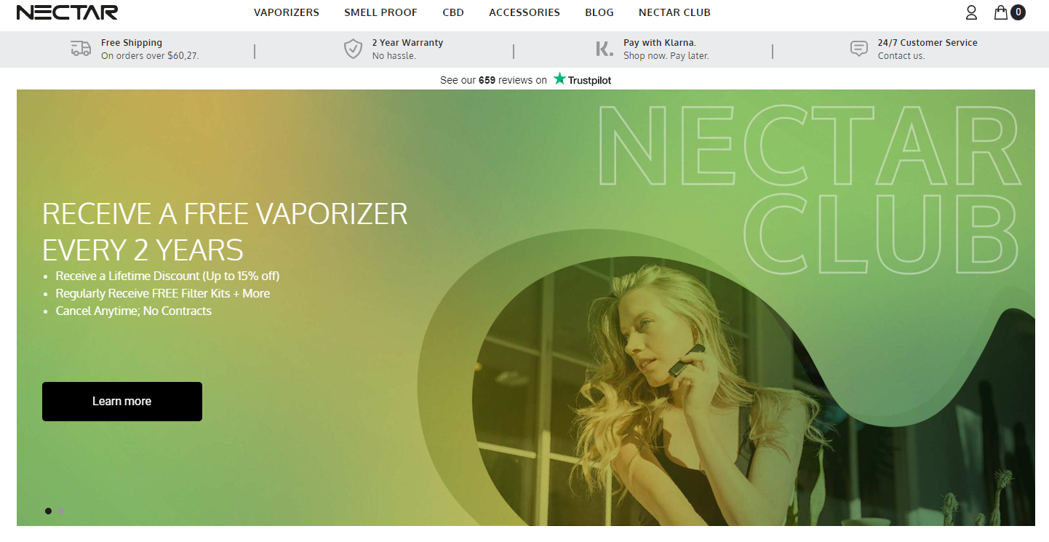
A D2C Company Measures Direct Revenue Impact of Product Advertisements Embedded in their Blog Articles
A GOOGLE ANALYTICS CASE STUDY
The Outcome
We were able to develop the most efficient solution for capturing the revenue impact. The fully tested solution was ready and delivered in the expected time frame of 2 weeks.
Note: Maximum time was spent in testing and waiting for GA4 to reflect changes.
We also fixed GA4 setup gaps which would have negatively impacted all the dashboard reports with faulty and incomplete data. This was a great plus for the client.

