Slide 1

Troubleshooting a Long-Standing Purchase Order Data Discrepancy for a Footwear e-Commerce Company
A Google Analytics & Tag Manager Case Study
Client: www.softstarshoes.com

Slide 2

Troubleshooting a Long-Standing Purchase Order Data Discrepancy for a Footwear e-Commerce Company
A Google Analytics & Tag Manager Case Study
About the Client
The Handmade Barefoot-Shoe Company
Softstar sells minimal footwear, handmade bare-foots, through their e-commerce site www.softstarshoes.com. On a mission to create an environment-friendly shoe business, Softstar has a fast-growing audience in the US and abroad.
With the e-commerce site built on Magento, Softstar uses Google Analytics, Google Tag Manager & Plugins to analyze site conversion data.
But the Google Analytics purchase data was gravely mismatched with the purchase orders recorded in Magento.

Slide 3
Troubleshooting a Long-Standing Purchase Order Data Discrepancy for a Footwear e-Commerce Company
A Google Analytics & Tag Manager Case Study
The Requirement
Solve the Case of Serial Disappearance
The problem statement given to us was “find the root cause at the very least”
Google Analytics data had started to go awry. Purchases displayed in the Google Analytics reports were way off from orders in the backend.
When we first interviewed Benjamin, the marketing manager in charge, he told us that purchases missing from GA reports were a long-standing problem.
He most urgently wanted us to find out why certain shoe sales don’t appear in Google Analytics. His team had repeatedly checked configurations. They were certain that there were no errors in GTM, GA4, or Magento setups. So, why were so many purchases missing from GA reports every month?

Slide 4
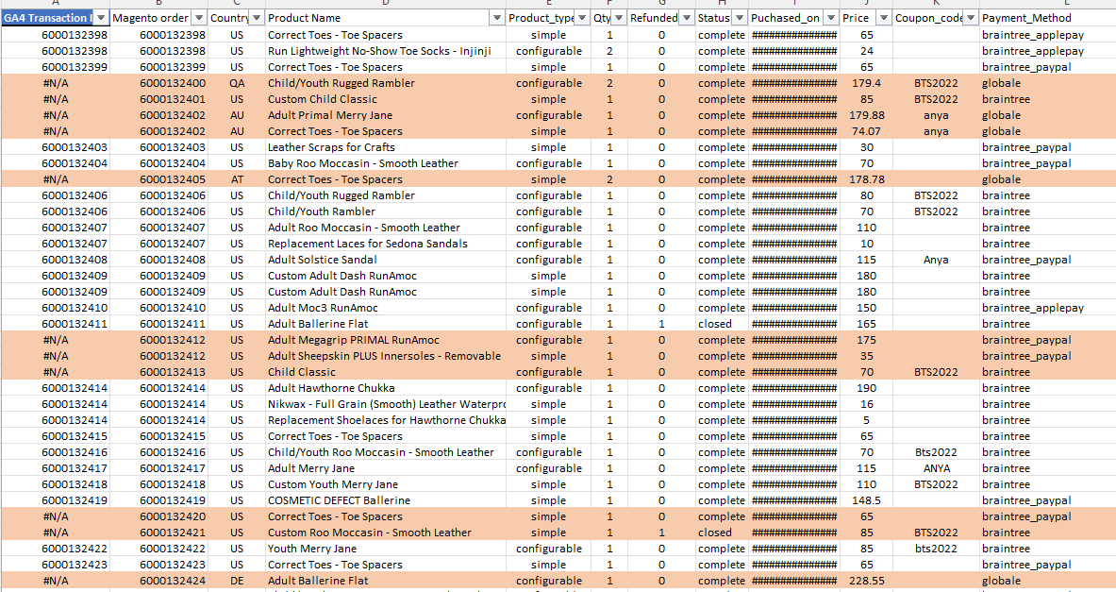
A Google Analytics & Tag Manager Case Study
Troubleshooting a Long-Standing Purchase Order Data Discrepancy for a Footwear e-Commerce Company
The Complexity
Random Disappearance. No Clues.
The tricky part was that the discrepancies showed no pattern. On a good day, the Google Analytics data at best matched 40% with the actual purchases.
When we investigated further, Benjamin told us he had approached many agencies and Google Analytics experts. But none of them were able to give him a reliable analysis. Nobody could even suggest an approach.
Was it a GA / GTM configuration problem, a data problem, a Magento issue, a bug somewhere, or something else? Nobody could tell. It was as if a lurking beast was gobbling the data at large whenever it desired.
We knew from the very beginning a structured testing approach was crucial.

Slide 5
A Google Analytics & Tag Manager Case Study
Troubleshooting a Long-Standing Purchase Order Data Discrepancy for a Footwear e-Commerce Company
Our Approach
Set the Baits & Follow the Trails
We conducted a few random tests in the beginning to replicate the problem. From there we arrived at a set of seven high-level categories of testing scenarios.
We covered the common suspects like geography (US-based or international transactions), time of the day, browser configurations, device type, internet connections, product categories, and such.
Then we started creating the tests, generating log trails from GTM to Google Analytics to Magento. Starting with a blank slate and no assumptions we worked through the scenarios systematically, picking logs and looking at trails for patterns.
All-in-all we Designed 42 Test Cases

Slide 6
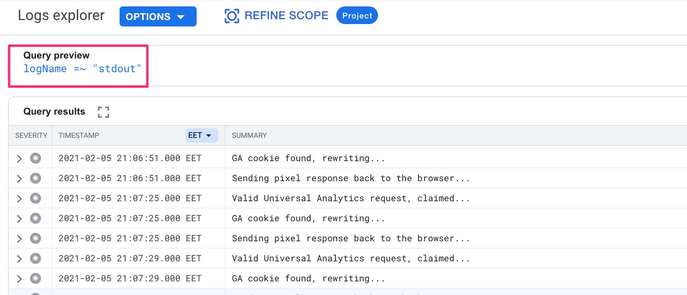
A Google Analytics & Tag Manager Case Study
Troubleshooting a Long-Standing Purchase Order Data Discrepancy for a Footwear e-Commerce Company
Our Findings
Arriving at the Truth by Negation
Analyzing the logs we realized that most of the time when data was missing in GA reports, GTM Tags were not firing. Following this track, we discovered that the data layer was not getting populated in all these cases.
The question was - In what scenarios was Data Layer not getting populated? Was this a function of geography, browser, device type, user type, or any other factor? With a systematic pattern discovery and logical inferences, we started filtering-out factors.
Eventually, the only reason was delayed data Layer population. This along with these two reasons - slow internet speed & presence of ad blockers aggravated the problem. Be it an international transaction or domestic, any browser or device, whenever the internet speed was slow or an ad blocker was used, the chances of the tags not firing were the highest. Now it was time to pick the elephant in the room.

Slide 7
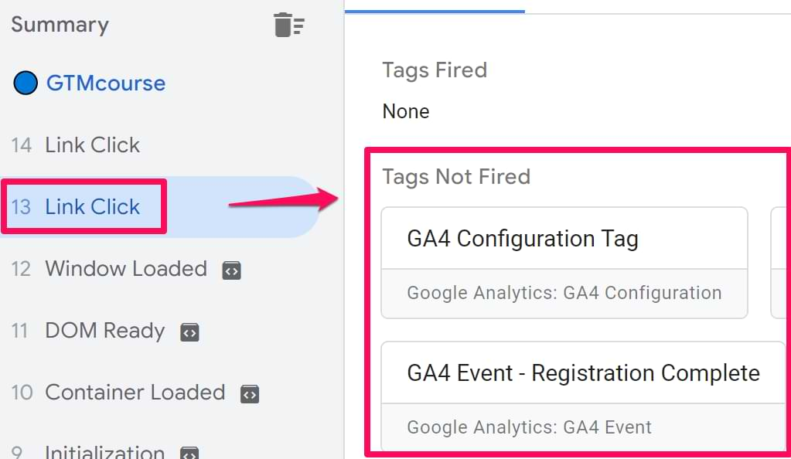
A Google Analytics & Tag Manager Case Study
Troubleshooting a Long-Standing Purchase Order Data Discrepancy for a Footwear e-Commerce Company
The Discovery & The Solution
Disable the Transaction Gobbler
A revisit to the setup revealed that two Google Tag Manager plugins were doing the same job of populating the Data Layer.
We inferred that slow internet and ad blockers were resulting in a Tag Manager time-out.
The solution? Finding which of the plugin was causing delayed data Layer population.
After through research, we presented this solution and the logic to the team. We asked them to test out the changed configuration for a few days. After a week, the team reported that there was 93% match with the purchase order data as compared to 70% match before the change

Slide 8
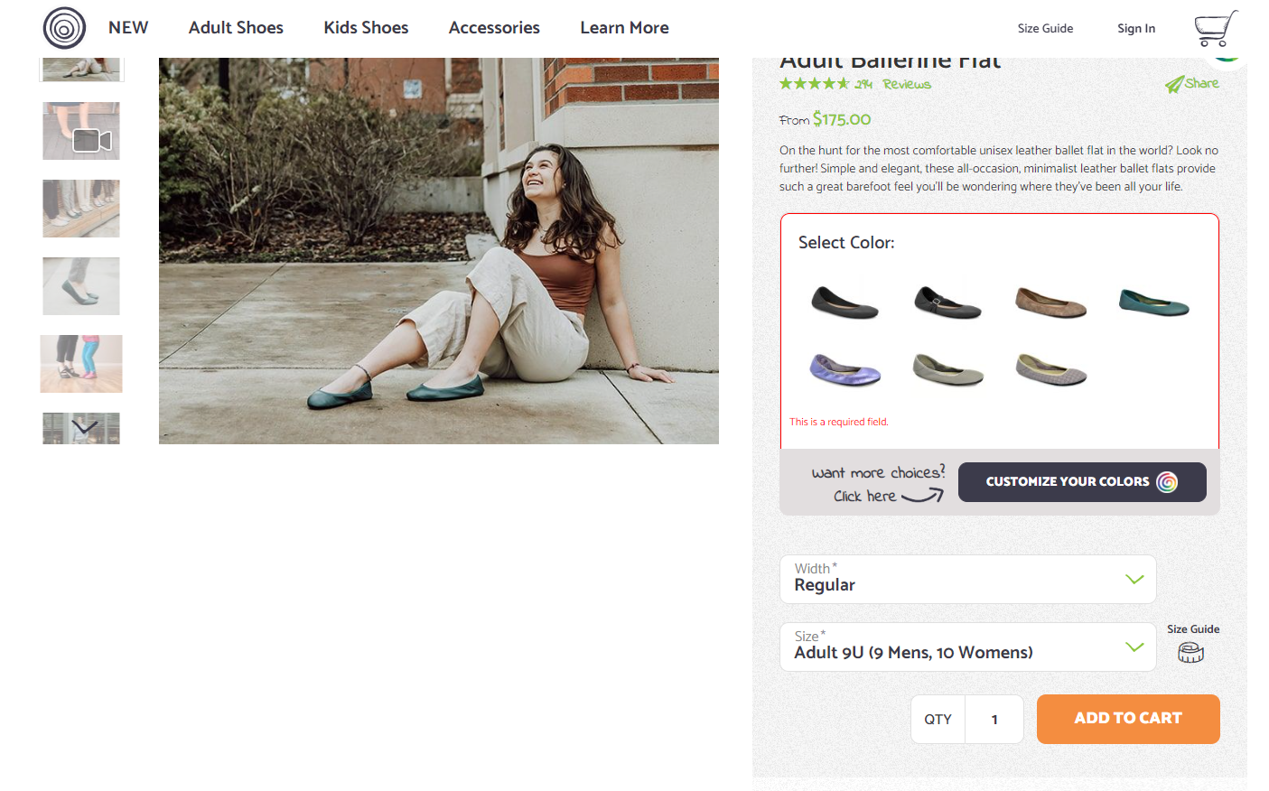
A Google Analytics & Tag Manager Case Study
Troubleshooting a Long-Standing Purchase Order Data Discrepancy for a Footwear e-Commerce Company
The Final Fix
The Customer Journey Slippers
After the disabling the plugin, we started diving into GTM Tag setups. We created different customer journeys to analyze the data mismatch if
Because the Google tag manager hadn’t being maintained for sometime, it had a legacy setup. It left out a small chunk of customer journeys where the buyers would navigate back to a blog or view other shoes and then comes back to the checkout screen much later.
We asked the team to make the changes to accommodate all pages and customer journeys. Soon they reported success with over 96% of data match

Slide 9

A Google Analytics & Tag Manager Case Study
Troubleshooting a Long-Standing Purchase Order Data Discrepancy for a Footwear e-Commerce Company
The Outcome
The Case Solved
The root cause was successfully discovered.
A foolproof solution was provided.
Over 95% of Google Analytics data now matches with backend order data in Magento.

